Slide 1
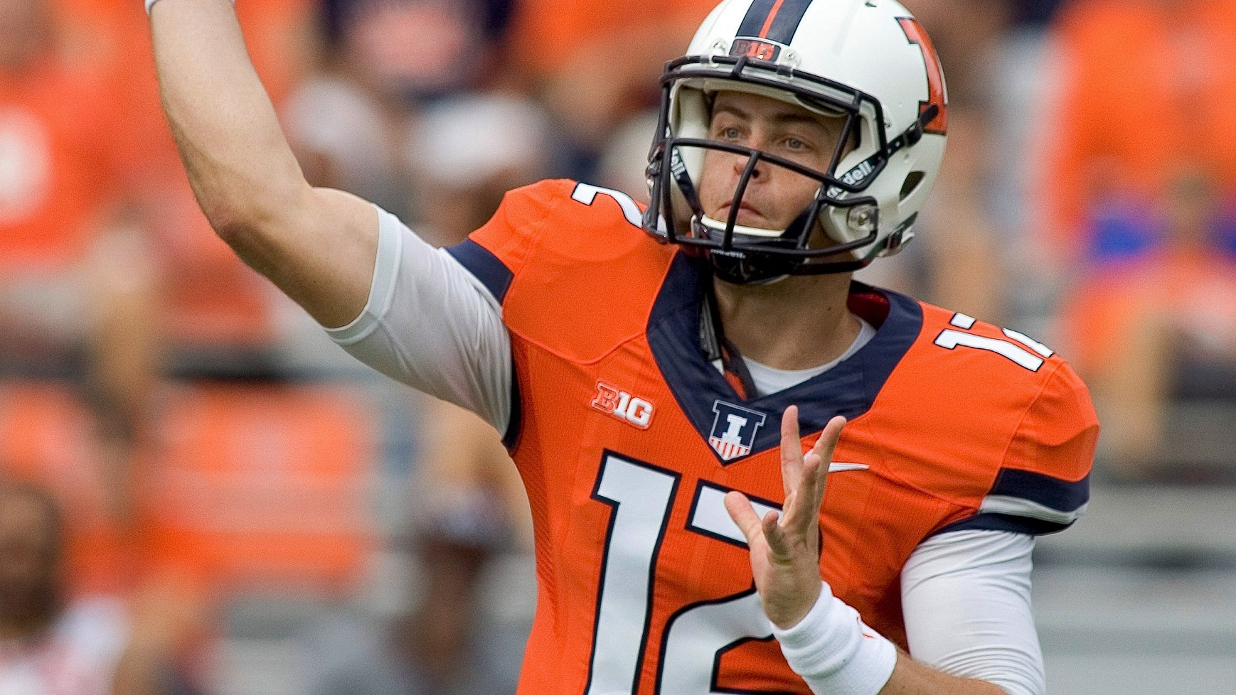

A Bayesian Approach to Predicting NFL Quarterback Scores in Fanduel Tournaments
Aaron Ray (aaronwr2)
Michael Chan (mhchan3)
Kiomars Nassiri (nassiri2)
STAT 578 - ABM

Slide 2

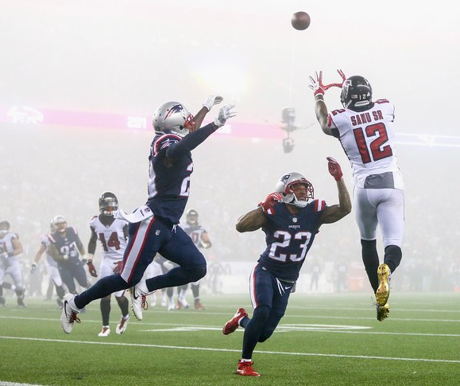
Fantasy Football
Participants in a Fantasy Football game act as the managers of a virtual football team and try to maximize their points by picking up the best line-up.
Points are given based on actual performance of players in real-world competition.
Each team is allowed a pre-determined number of players on its roster, as well as a specified number at each position that can or must be used in each game (the "starters").

Slide 3
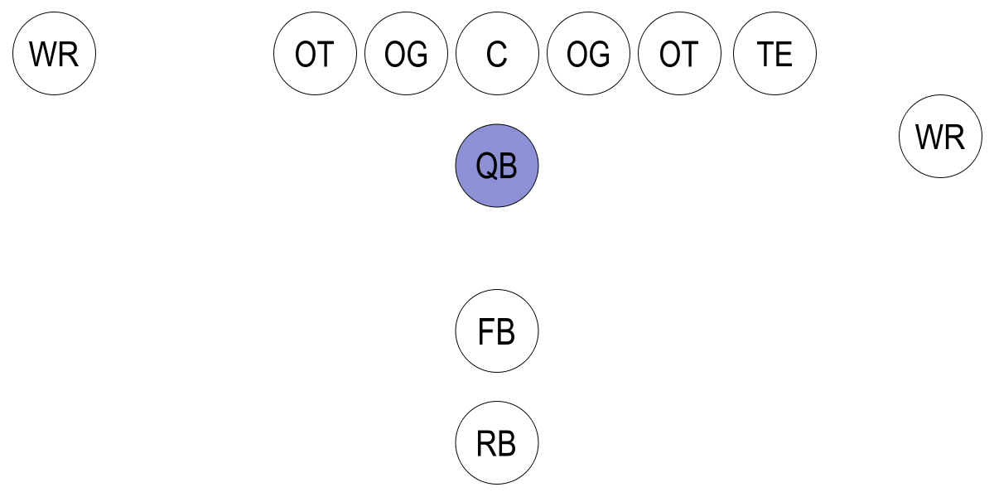
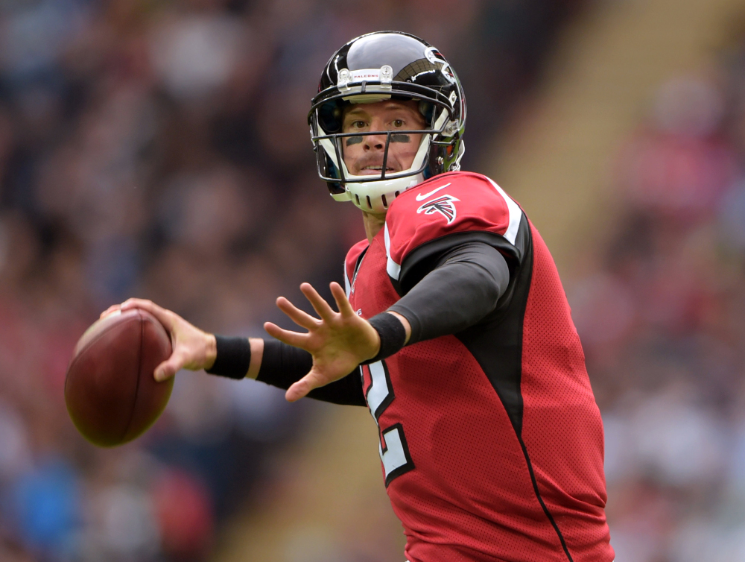
Quarterback (QB)
In this project, we are creating our Bayesian Model for the Quarterback position players.
Quarterbacks are usually considered the leader of the offensive team and they line up directly behind the offensive line.
“The quarterback touches the ball on almost every offensive play, and his successes and failures can have a significant impact on the fortunes of his team.” – Wikipedia

Slide 4

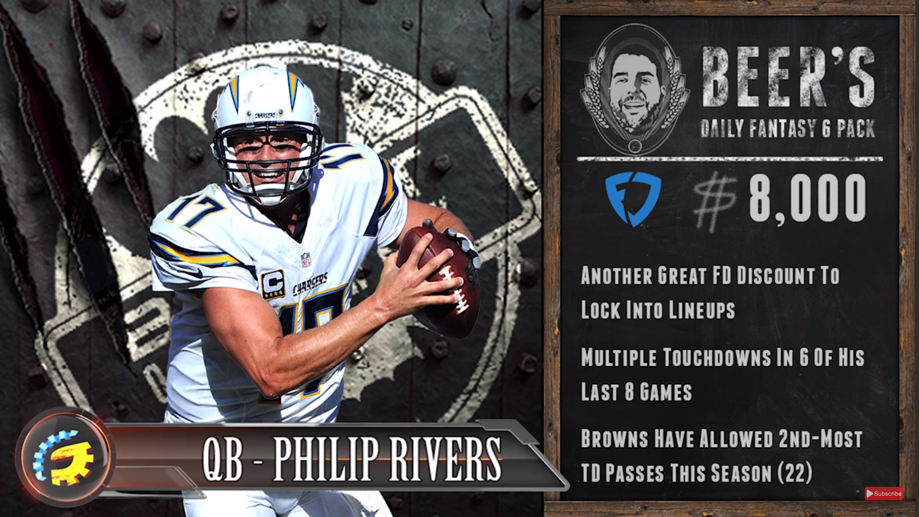
FanDuel
For the purpose of this project we have chosen to work with the data gathered from the FanDuel internet company.
“FanDuel is a web-based fantasy sports game and with 6 million registered users and is the second largest daily fantasy sports company (as measured by entry fees and user base) in the daily fantasy sports industry” – Wikipedia

Slide 5
Objective & Research Questions
We have leveraged a Hierarchical Bayesian approach with the Markov Chain Monte Carlo method to predict the fantasy points likely to be scored by an NFL quarterback in any given game.
In this project we are interested to know:
What features can help us effectively predict Fanduel points players receive in a future match?
How reliable are the predictions for the future performance of players?

Slide 6

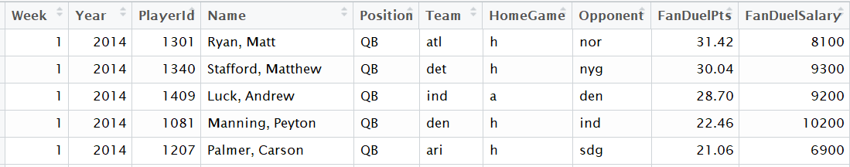
Dataset – Fanduel Stats
Historical data on the performance of the players is extracted from the RotoGuru website.
Data scraped from RotoGuru has information about
The Fanduel points received by each player
Player’s position in a given week,
Player’s opponent team in a given week,
Home/Away match indication,
Etc.
Raw Data Fields
Week
Year
Player ID
Name
Position
Team
HomeGame
Opponent
FanDuelPts
FandDuelSalary

Slide 7
Data Preparation and Wrangling
Raw data, then, undergoes different data preparation processes as follows:
Data Cleansing:
Removing invalid records, binarizing indicator columns, Fixing naming issues, etc.
Data Wrangling – Running Calculations
Points Allowed to Position (PAP):
6-week running mean and SD of PAPs are calculated for each record.
PAP represents the typical total points that each player’s opponent has allowed to players of that position in any given game.

Slide 8
Data Preparation and Wrangling (cont’d)
Data Wrangling - Running Calculations (cont’d)
Points Scored:
5-week running mean and SD of the points scored by players who play a certain position for a given team.
Offensive and Defensive Ranks:

Slide 9
Bayesian Hierarchical Model
DAG For the Model
General Model Descriptions – Refer to Course slides.

Slide 10
Bayesian Hierarchical Model
Sampling Distribution:

Slide 11
Bayesian Hierarchical Model
Diffuse Prior Distributions:

Slide 12
Bayesian Hierarchical Model
DAG For the Model

